Slide 1
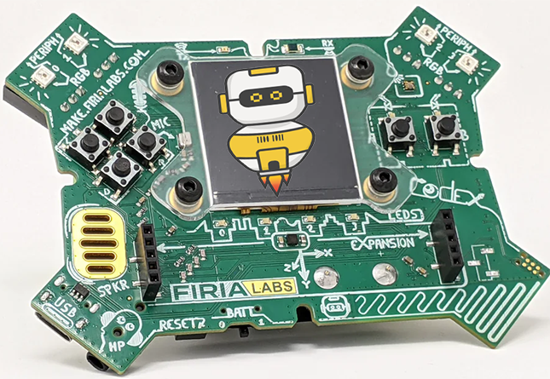
CodeX Unit 2 Remix
Create your own project based on Missions 6-8

Slide 2
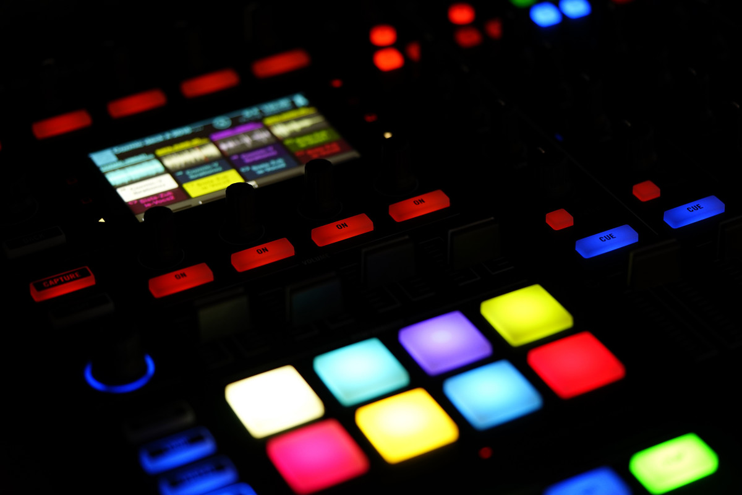
Time for a coding remix!
A new program is created by adding new code and parts of code from programs you already created.
Or use a similar idea in a different way.

Slide 3
Project Remix
Creating a remix will let you:
Improve your skills and practice the concepts from the mission.
Be creative.
Remember code from earlier programs and missions.
Work with other students.
Design an original program and write the code all on your own.

Slide 4
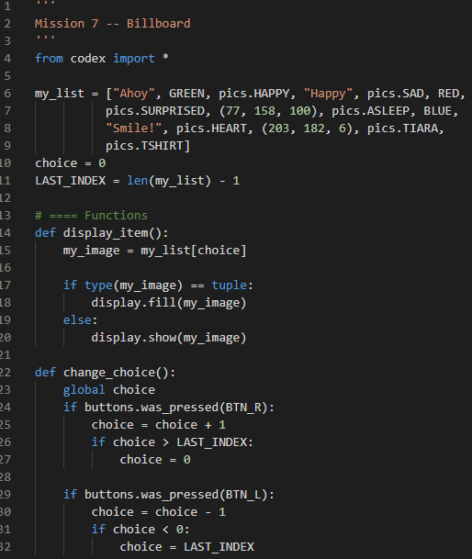
Step #1
Getting Started
Open your programs from Mission 6, Mission 7 and Mission 8:
Heart2_functions
Billboard_functions
Answer_Bot
Review what each program does.
Review the concepts and skills used.
Notes:
.

Slide 5
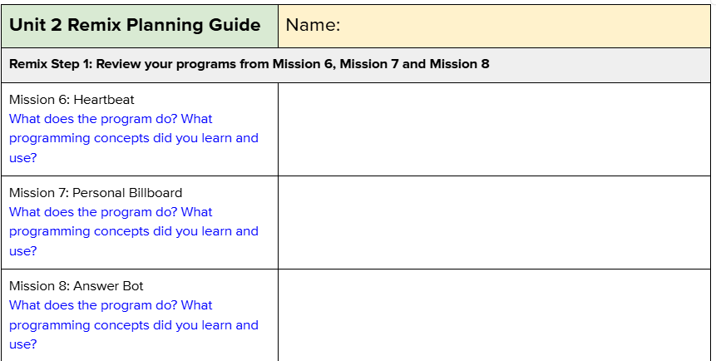
Step #1
DO THIS:
Fill out the information in the Planning Guide for Step 1

Slide 6
Step #2
Brainstorm ideas
Read through remix ideas for each mission.
Read through Unit 2 Remix suggestions.
You can use any of these ideas or come up with your own.

Slide 7
Step #2 Remix Ideas
Mission 6 Remix Ideas
MILD: Add flashing pixels to the heartbeat.
MILD: Add a kill switch to the program to stop the loop. Clear the display.
MEDIUM: Add audio to the heartbeat, with two different pitches or sound.
MEDIUM: Change the heartbeat to racing pixels. Go from pixel 0 to 3, flashing one on an off before moving to the next. Then repeating. Use the buttons to control the speed of the racing lights.
SPICY: Change the heartbeat to different images, like arrows. Add an intro that explains what the button presses do. Also include a kill switch and ending message.

Slide 8
Step #2 Remix Ideas
Mission 7 Remix Ideas
MILD: Add pixels colors to the images, displaying a different color with each image.
MEDIUM: Create two lists: one for images and one for sounds. Then use the same “choice” variable as an index for the lists so the sound at the same index plays when the image at the index is displayed.
MEDIUM: Create a list of text strings with facts from a subject, like math or history. Scroll through the list to display the facts.
SPICY: Create two different lists. Select which list to display an item from by using BTN-A and BTN-B. Then scroll through the chosen list with BTN-R and BTN-L.

Slide 9
Step #2 Remix Ideas
Mission 8 Remix Ideas
MILD: Create two lists of different lengths and with different types of items. Use one button press to select a random item from the first list, and a different button press to select a random item from the second list.
MEDIUM: Create your own list of colors. Choose a random color for Pixel 0 and 1, and a different random color for Pixel 2 and 3.
MEDIUM: Add text and colors to your list. Then select a random item from the list and display it. Optionally, add audio to the list instead of text.
SPICY: Create a dice roller, showing the number of a 6-sided die. Change the scale of the text so the number is large. Show a message like “rolling, rolling, rolling” before displaying the number.

Slide 10
Step #2 Remix Ideas
Mild
Create a 2-person (or more) billboard. Use a different list and button for each person. Light up a pixel for which person is currently selecting from the billboard. Make sure to turn off the pixel when a different person is selecting.
Medium
Create a program that scrolls through a list (use two buttons) and also selects a random item from the list (use a different button). You can add a kill switch and instructions so the user knows what buttons to press.

Slide 11
Step #2 Remix Ideas
Medium
Create a program that shows an interest of yours. Use several lists and buttons to display different types of information. For example, if you like a particular musician, one list could be images of the musician. Another list could be songs. Another could be album covers.
Spicy
Combine the heartbeat program with the billboard and answer bot. Scroll through a list in both directions and also select a random item. For each item, create an animation between two images, or with pixels.

Slide 12
Step #2
Brainstorm ideas
Read through remix suggestions.
Use the suggestions –or–
Use your creativity to come up with your own idea for a project.
Decide with your partner what project you will do.
DO THIS:
Fill out the information in the Planning Guide for Step #2

Slide 13
Step #3
Make a plan
What variables will you need? What will you use them for?
What will you program the buttons to do?
What will pixels will you light up? What color? When?
Will you use audio files? If so, when?
What text will you show or print?
What are some functions you can define and use?

Slide 14
Step #3
Make a plan
DO THIS:
Fill out the information in the Planning Guide for Step #3
Add to the Planning Guide with more information, as needed.
NOTE: You can modify your plan as you begin to program. You may come across more functions to create, LED uses, and more as you go.
You do not need to revise Step 3 while you work.

Slide 15
Step #3
Make a plan
DO THIS:
Use a piece of paper to write an algorithm for your project:
What happens first?
What happens next?
This algorithm will help you get started.
What do you need to import?
Are there functions you can start with?
What happens first in the main program?
What will happen in the button presses?

Slide 16
Step #4
Code your project
IMPORTANT: In CodeSpace, go to the sandbox.
Start a new file and give it a descriptive name (Remix2).
You can leave other programs open and use them as a guide.
Import your modules.
Define your variables.
Write functions near the top of your code.
Write function calls and other instructions in the main program.
Write your code a little bit at a time, testing frequently.

Slide 17
Step #4
Stop and test frequently!
Don’t try to write all the code at one time.
Think about the steps:
Just get one thing to work, then move on.
Step by step!
Mistakes happen, so find them early.
Type just a few lines of code and then run the program.
If there is an error, fix it before continuing. Ask others for help.
Use your other programs and classmates for help.

Slide 18
Step #4
Documentation!
Make sure your code is readable by adding blank lines.
Add comments to sections of your code that explain what they do.

Slide 19
Step #5
Get feedback and Revise
After you code is finished, show the program to other students.
What do they think? Have them fill out the feedback form on your Planning Guide.
The Planning Guide has space for two people to give feedback. The feedback can come from two peers or one peer and yourself.
Use the peer reviews to modify your code and make your project even better

Slide 20
And now you have your own remix!
Congratulations!
By completing this remix you have:
learned more about programming,
practiced the skills and concepts from the missions,
been thinking! And problem solving and much more!

Slide 21
Mission Reflection
Wow! Great job!
Share your project with your friends!
Run projects from other students.
Complete the Post-Remix Reflection in the Planning Guide.

